Slide 1
Computer Organization
2015 - 2016

Slide 2
Instructions
Language of The Computer
(MIPS)

Slide 3
Memory organization
Information is stored in the memory as a collection of bits.
Collection of bits are stored or retrieved simultaneously is called a word
Number of bits in a word is called word length
Word length can be 16 to 64 bits
Collection of 8 bits known as a “byte”
Word length of 16 bits, is equivalent to word length of 2 bytes
Words may be 2 bytes (older architectures), 4 bytes (current architectures), or 8+ bytes (modern architectures).

Slide 4
Memory organization (cont.)
Accessing the memory to obtain information requires specifying the “address” of the memory location
Addresses are assigned to a single byte. “Byte addressable memory”
Suppose k bits are used to hold the address of a memory location: size of the memory in bytes is given by 2^{k}
For example, a 24-bit address generates an address space of 2²⁴ (16,777,216) locations (bytes)

Slide 5
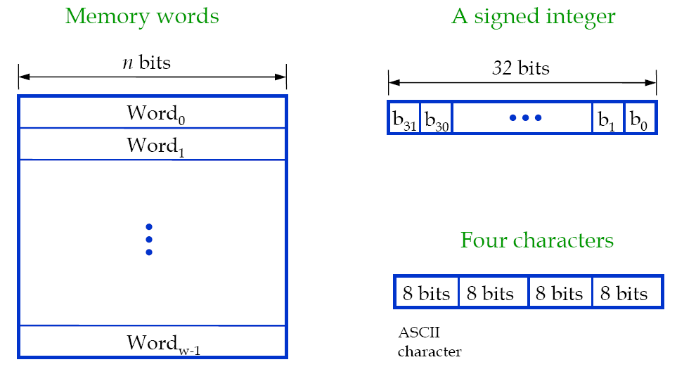
Memory Words

Slide 6
Memory organization
Word #0
Byte 0
Byte 1
Byte 2
Consider a memory organization:
16-bit memory addresses
Size of the memory is ?
2¹⁶ Bytes
Word length is 4 bytes
Number of words = Memory size(bytes) = ?
Word length(bytes)
Word #0 starts at Byte #0.
Word #1 starts at Byte #4.
Byte 3
Word #1
Byte 4
Word #?
Byte 65532
Byte 65533
Byte 65534
Byte 65535

Slide 7
Execution of an instruction
The steps involved in the execution of an instruction by a processor:
Fetch an instruction from the memory.
Fetch the operands.
Execute the instruction.
Store the results.
Basic processor architecture has several registers to assist in the execution of the instructions.

Slide 8
Registers in the control path
Instruction Register (IR):
Instruction that is currently being executed.
Program Counter (PC):
Address of the next instruction to be fetched and executed.
Memory Address Register (MAR):
Address of the memory location to be accessed.
Memory Data Register (MDR):
Data to be read into or read out of the current memory location, whose address is in the Memory Address Register (MAR).

Slide 9
Basic Processor Architecture
Memory
Address of the memory
location to be accessed
Address of the next
instruction to be fetched
and executed.
Data to be read into or
read out of the current
location
MAR
MDR
Control
PC
R0
R1
General purpose
registers
Instruction that is
currently being
executed
IR
ALU
R(n-1)
-
general purpose
n
registers
Processor

Slide 10
Basic processor architecture (cont.)
Control
Path
Data
Path
MAR
MDR
Processor
Control path is responsible for:
Instruction fetch and execution sequencing
Operand fetch
Saving results
Data path:
Contains general purpose registers
Contains ALU
Executes instructions
Memory

Slide 11
Fetch/Execute cycle
Execution of an instruction takes place in two phases:
Instruction fetch.
Instruction execute.
Instruction fetch:
Fetch the instruction from the memory location whose address is in the Program Counter (PC).
Place the instruction in the Instruction Register (IR).

Slide 12
Fetch/Execute cycle (cont.)
Instruction execute:
Instruction in the IR is examined (decoded) to determine which operation is to be performed.
Fetch the operands from the memory or registers.
Execute the operation.
Store the results in the destination location.
Basic fetch/execute cycle repeats indefinitely.

Slide 13
Byte 0
Word #0
Byte 1
Byte 2
MAR
Byte 3
Byte 4
Word #1
MDR
MAR register
contains the
address of the
memory location
addressed
Addr 65532
Byte 65532
Word #16383
Byte 65533
MDR contains either the
data to be written to that
address or read from that
address.
Byte 65534
Byte 65535

Slide 14
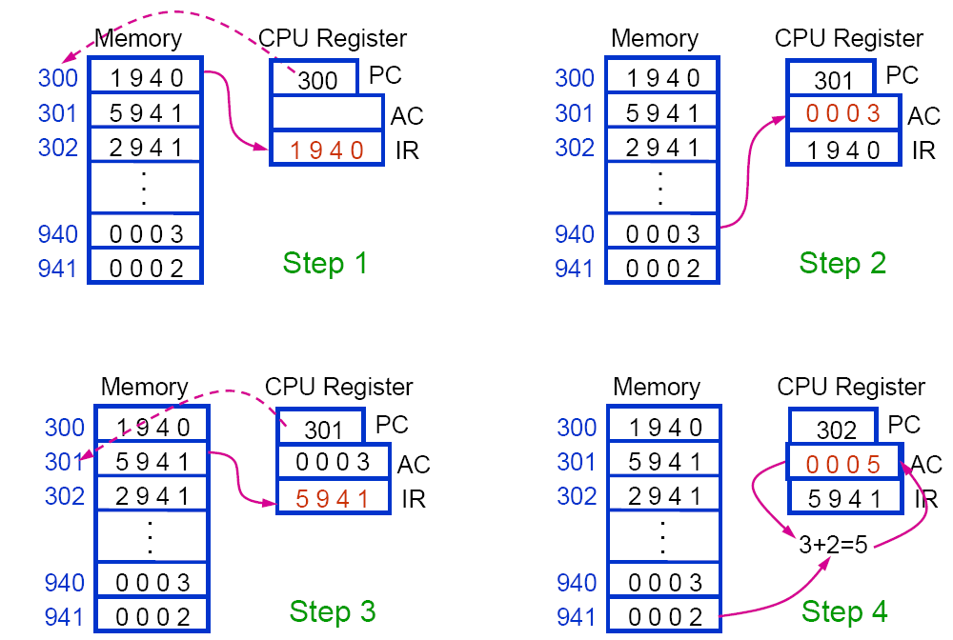
Notes:
1 --→load
5--→ add
2---→store

Slide 15
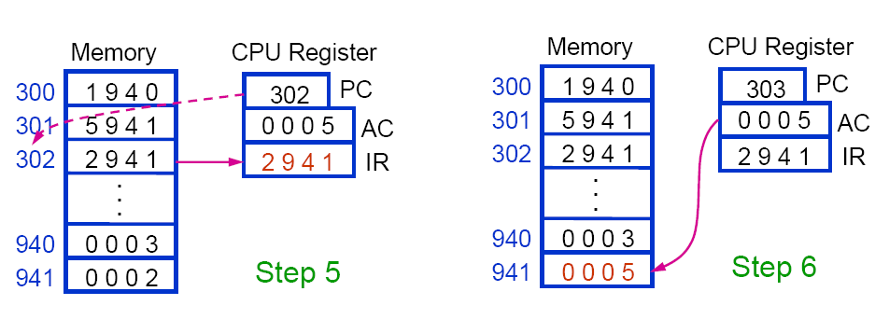

Slide 16
Addressing Modes
A high-level language enables the programmer to use constants, local and global variables, pointers, and arrays
When translating a high-level language program into assembly language, the compiler must be able to implement these constructs using the facilities in the instruction set of the computer
The different ways in which the location of an operand is specified in an instruction are referred to as addressing modes

Slide 17
Addressing Modes (cont.)
Some of important addressing modes are:
Immediate mode
Register mode
Absolute mode
Indirect mode
Index mode

Slide 18
Addressing Modes (cont.)
Immediate mode
Operand is given explicitly in the instruction.
E.g. Move R0, 200
Can be used to represent constants.
Register mode
Operand is the contents of a processor register.
Address of the register (its Name) is given in the instruction.
E.g. Clear R1 or Move R1, R2

Slide 19
Addressing modes (cont.)
Absolute mode
Operand is in a memory location.
Address of the memory location is given explicitly in the instruction.
E.g. Clear A or Move R2, LOC
Also called as “Direct mode” in some assembly languages

Slide 20
Addressing Modes: Indirection and Pointers
Indirect mode:
the effective address of the operand is the contents of a register or memory location whose address appears in the instruction
Indirection is denoted by placing the name of the register or the memory address given in the instruction in parentheses
The register or memory location that contains the address of an operand is called a pointer
E.g. Move R1, (R2): in this case R2 contains the address of the operand to be loaded in R1

Slide 21
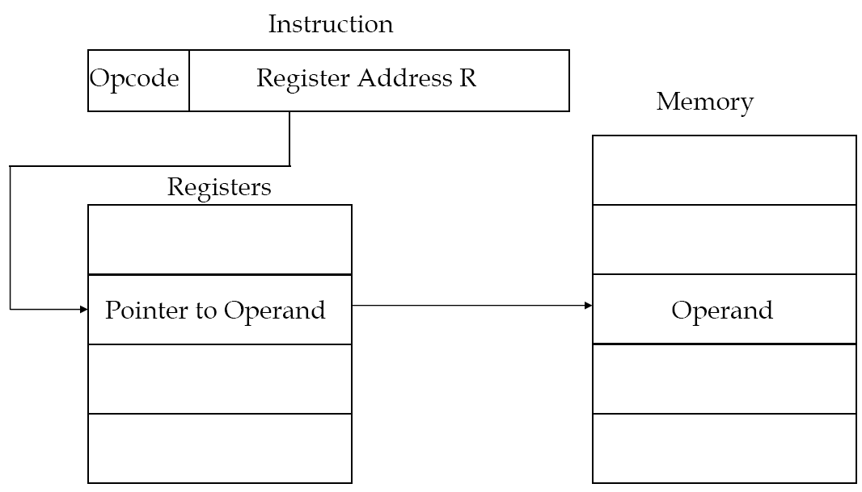
Register Indirect Addressing Diagram

Slide 22
Addressing Modes: Indexing and Arrays
Index mode
the effective address of the operand is generated by adding a constant value to the contents of a register
The index mode is useful in dealing with lists and arrays
We denote the Index mode symbolically as X(Ri), where X denotes the constant value (offset) contained in the instruction and Ri is the name of the register involved.
The effective address of the operand is given by EA=X+(Ri).
E.g. Move R1, X(R2): in this case X+R2 represents the address of the operand to be loaded in R1

Slide 23
Instruction types
Computer instructions must be capable of performing 4 types of operations.
Arithmetic and logic operations:
E.g., addition, subtraction, comparison between two numbers.
Data transfer/movement between memory and processor registers.
E.g., memory read, memory write
Program sequencing and flow of control:
Branch instructions (decisions and loops)
Input/output transfers: to transfer data to and from the real world.

Slide 24
MIPS Arithmetic operations
MIPS assembly language notation for arithmetic operations:
operation destination, source1, sourse2
Each MIPS arithmetic instruction performs only one operation
Each MIPS arithmetic instruction must have exactly three operands
Operand order is fixed (destination first)
The words to the right of the sharp symbol (#) are comments
Comments always terminate at the end of a line

Slide 25
Exercise (1)
Write a MIPS assembly code that places the sum of the four integer variables b, c, d, and e into integer variable a, then subtracts integer variable f from a and puts the result in integer variable g
C code:
a = b + c + d + e;
g = a - f;

Slide 26
Exercise (1) Sol.
C code:
a = b + c + d + e;
g = a - f;
MIPS code:
add a, b, c # b + c → a
add a, a, d # a + d → a
add a, a, e # a + e → a
sub g, a, f # a - f → g

Slide 27
MIPS Operands
In MIPS, arithmetic instructions’ operands must be registers
MIPS has only 32 registers (limited number!) • For MIPS, a word is 32 bits (or 4 bytes) •
MIPS registers hold 32 bits of data (a word size)
MIPS is a general-purpose register architecture
MIPS registers are general-purpose registers (GPRs)
MIPS registers can be used for addresses or data with any instruction
It is the compiler’s job to associate program variables with registers

Slide 28
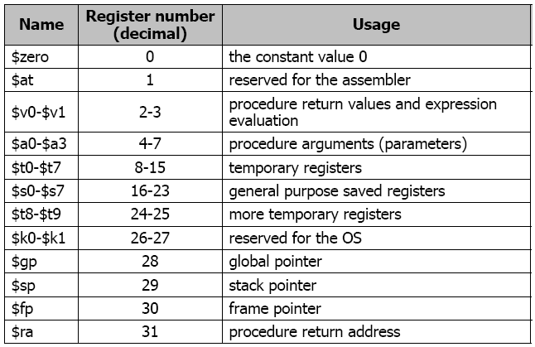
MIPS Registers

Slide 29
Exercise (2)
The following C statements contain the six integer variables e, f, g, h, i, j:
f = (g + h) - (i + j);
e = f;
Suppose that the compiler associates variables e, f, g, h, i, and j with registers $s0 through $s5, respectively
What is the compiled MIPS assembly code?

Slide 30
Exercise (1) Sol.
C code:
f = (g + h) - (i + j);
e = f;
MIPS code:
add $t0, $s2, $s3 # $t0 is a temporary register
add $t1, $s4, $s5 # $t1 is a temporary register
sub $s1, $t0, $t1
add $s0, $s1, $zero # copy f ($s1) to e ($s0)

Slide 31
Data Transfer Instructions
Data transfer instructions: transfer data between memory and registers
load word (lw): copies a word from memory to a register
store word (sw): copies a word from a register to memory
lw $s0, c ($s1) # Memory [$s1 + c] → $s0
sw $s0, c ($s1) # $s0 → Memory [$s1 + c]
$s1 is the Index (base) register
constant c is the offset
MIPS memory is only accessed through loads and stores

Slide 32
Exercise (3)
Registers $s1 and $s2 of a computer contain the decimal values 1200 and 4600. What is the effective address of the memory operand in each of the following instructions? And explain their action.
lw $S4,20($S1)
sw $S5, 1000($S2)

Slide 33
Exercise (3) Sol.
For the instruction: lw $S4,20($S1)
The address is:20+1200=1220
it reads the word in the memory location 1220 and loads it in the register $s4
For the instruction: sw $S5, 1000($S2)
The address is:1000+4600=5600
it writes the word in the register $s5 to the memory location 5600 and loads it in

Slide 34
Exercise (4)
Lets also assume that the base address of the integer array d is in register $s4 and a value is in register $s1
Compile the following C statement into MIPS assembly code:
d[3] = d[2] + a;

Slide 35
Exercise (4) Sol.
C code:
d[3] = d[2] + a;
MIPS code:
lw $t0, 8($s4) # Memory [$s4 + 2*4] → $t0
add $t0, $t0, $s1 # $t0= $t0+ $t1
sw $t0, 12($s4) # $t0 → Memory [$s4 + 3*4]

Slide 36
Exercise (5)
Lets assume that the compiler has associated integer variables h and i with registers $s2 and $s4, respectively
Lets also assume that the base address of the integer array A is in register $s3
Compile the following C statement into MIPS assembly code:
A[i] = h + A[8];

Slide 37
Exercise (5) Sol.
C code: A[i] = h + A[8];
MIPS code:
lw $t0, 32 ($s3) # Memory [$s3 + 8*4] → $t0
add $t0, $s2, $t0 # h + A[8] → $t0
add $t1, $s4, $s4 # $t1 = 2*i
add $t1, $t1, $t1 # $t1 = 4*i
add $t1, $t1, $s3 # $t1 = $s3 + 4*i (address of A[i])
sw $t0, 0 (t1) # $t0 → Memory [$t1]

